Slide 1
DEBS 2013 project
Paola Sanfilippo 882892
Francesco Tinarelli 883738
Marco Wenzel 883732

Slide 2
INDEX OF CONTENTS
Assumptions
Exploited Technologies
Design
Results and conclusions

Slide 3
INDEX OF CONTENTS
Assumptions
Exploited Technologies
Design
Results and conclusions

Slide 4
ASSUMPTIONS
Full-game.csv

Slide 5
ASSUMPTIONS
ball.csv
Nick Gertje.csv
Kevin Baer.csv
Ben Mueller.csv
sensors directory
Full-game.csv
and so on, one file for each player!

Slide 6
ASSUMPTIONS
Every new csv is composed by:
ts, sensor id, x, y, z
All the timestamps of all the files are rewritten in milliseconds
In the file there are only the usefull data:
the timestamp and the relatives position given before the game start, during the first
half pause, after the end of the game and the ones in an interruption interval are
cut off

Slide 7
INDEX OF CONTENTS
Assumptions
Exploited Technologies
Design
Results and conclusions

Slide 8
EXPLOITED TECHONOLOGIES
We used CLion as development environment and MinGW with OpenMP and Boost libraries for file managing.
We chose to avoid the usage of MPI because we have 17 files with quite little dimensions: working on a distributed system, MPI would add an overhead to every communication between processes, invalidating the performances.
Using OpenMP, we parallelized on threads the computation. We used a Dell Inspiron 7559 with a Intel core i7 quad-core processor, that allowed us to use up to 8 threads.

Slide 9
INDEX OF CONTENTS
Assumptions
Exploited Technologies
Design
Results and conclusions

Slide 10
DESIGN
Load of metadata and preprocessing
Chunks load
Chunk analysis
Display result

Slide 11
DESIGN: Load of metadata and preprocessing
Initialize all the metadata given
Write from the standard input the two parameters K and T
Preprocess the full-game.csv file, if it hasn’t already been disaggregated
And then run!
meta = Debs::saveMetadatas();
fullGame.fullGameInitialize("../../../Desktop/Middleware",meta ,interruption);
run(t, k, playersList, i, meta);

Slide 12
DESIGN: Chunks load
Load 1 second of data for the ball and for each one of the players
#pragma omp parallel num_threads(nthreads) { #pragma omp single { nextBegin = ball->chargeChunk(beginOfInterval); } #pragma omp for schedule(dynamic) for (unsigned long long int i = 0; i < playerList.size();i++){ auto p = playerList.at(i); p->chargeChunk(beginOfInterval, nextBegin); } };

Slide 13
DESIGN: Chunk analysis
Analyze the previously loaded chunks, searching, for every ball’s timestamp, the nearest player. If there is any, it updates his ticks.
#pragma omp parallel num_threads(nthreads) { #pragma omp for ordered schedule(static,1) for (int i = 0; i < ball->getChunkOfPositions().size(); i = i + 1) { auto b = ball->getChunkOfPositions().at(i); auto ballTimestamp = b.getTimestamp(); double distance = maxDistance; Debs::Player *nearPlayer = nullptr; for (unsigned long int j = 0; j < playerList.size(); j++) { auto p = playerList.at(j); auto position = p->getPosition(ballTimestamp); auto playerDistance = position.getDistance(b); if (playerDistance < distance) { distance = playerDistance; nearPlayer = p; } } if (nearPlayer != nullptr) { #pragma omp ordered { nearPlayer->addTick(); }; } } };

Slide 14
DESIGN: Display result
Every T cycle displays the partial results of the possesion
if (timeOutput == 0){ numberOfPrint = numberOfPrint + 1; std::cout << "Time of the match = " << Utils::fromSecondToTime(originalTimeOutput*numberOfPrint) << std::endl; for (int i = 0; i < playerList.size(); i++) { std::cout << "Possession time of " << playerList.at(i)->getName() << " " << Utils::fromMilliToTime(playerList.at(i)->getBallTicks()) << std::endl; if(metadatas.teams.isOfTeam(playerList.at(i)->getName(), Debs::Team::A)){ ticksTeamA = ticksTeamA + playerList.at(i)->getBallTicks(); } else{ ticksTeamB = ticksTeamB + playerList.at(i)->getBallTicks(); } } std::cout << "Total ticks team A = " << Utils::fromMilliToTime(ticksTeamA) << std::endl; std::cout << "Total ticks team B = " << Utils::fromMilliToTime(ticksTeamB) << std::endl; std::cout << "\n"; timeOutput = originalTimeOutput; }

Slide 15
INDEX OF CONTENTS
Assumptions
Exploited Technologies
Design
Results and conclusions

Slide 16
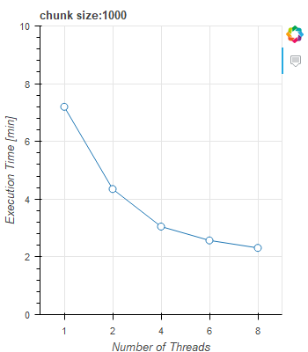
RESULTS AND CONCLUSIONS
Results using different numbers of threads with parameters:
T = 60 s and K = 2 m

Slide 17
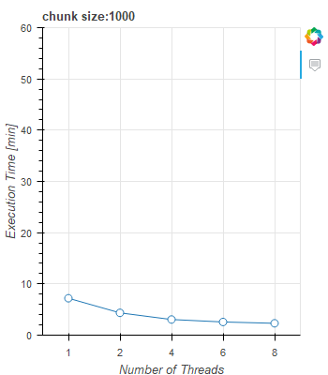
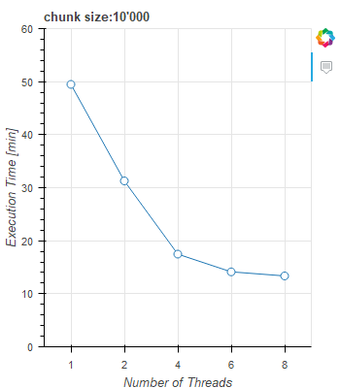
RESULTS AND CONCLUSIONS
Comparison between different chunk size
(T = 60 s and K = 2 m)

Slide 18
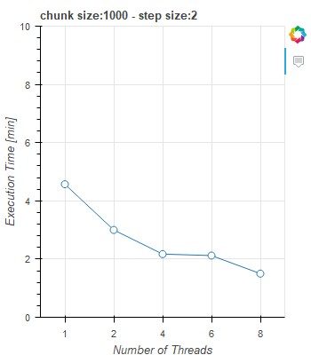
RESULTS AND CONCLUSIONS
Comparison between using all data and skipping one
(T = 60 s and K = 2 m)

